Slide 1
Creating Software
Building non-trivial Windows Applications

Slide 2
How do we make non-trivial software?
1. Understand the requirements
2. Plan what we are going to do
3. Implement the code
4. Validate the functionality

Slide 3
Three Questions
What is the functionality we want to implement?
How are we going to arrange the code?
What pre-existing technology can we leverage?

Slide 4
Relationship
Structure and arrangement of code should reflect the functionality
Make the code easier to read, understand, and manage
Knowing what the software does is critical to making choices
For example which technology or libraries to use
The choice of library and technology feeds back into process
Affects what is feasible to do in a reasonable amount of time

Slide 5
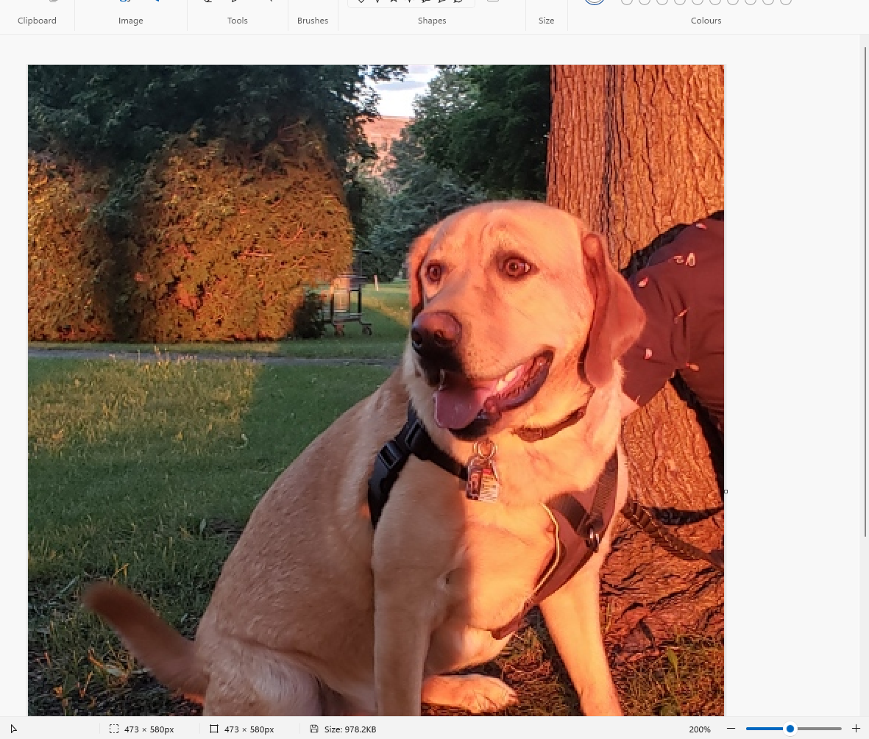
Consider MSPaint

Slide 6
Basics
Read and write image data from file
Display image data in a window
Allow some editing

Slide 7
What can it do in more detail
Draw lines, shapes (outlined or filled), images on a canvas
Open and save files, import images
Select a region and cut/copy/paste
Update the canvas
Flip, rotate, resize, crop regions
Zoom in / out
Undo / redo
Move/Resize/Minimize/Maximize/Close window

Slide 8
Major Areas
Files - open, save, check if modified, recent files
Keyboard and mouse
Window and UI – title, menu, toolbar, context, and shortcuts
Image Edits Selection - skew, crop, flip, rotate, resize
Clipboard - cut, copy, paste, import
Drawing Tools – shapes, lines, fill, erase,
Properties of Drawing Tools – color, fill, brush

Slide 9
What are the UI components?
Window border
Title
Menu
Toolbar
Status bar
Border
Shadow
Minimize/Maximize/Close

Slide 10
Drawing Tools
Write text
Draw brush
Make shape (filled or not)
Select and edit region

Slide 11
Standardized Stuff
Color picker
Font chooser
Open file dialog
Save file dialog
Page set-up
Print

Slide 12
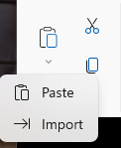
Clipboard
Cut
Copy
Paste
Import

Slide 13
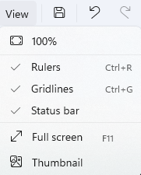
View Options

Slide 14
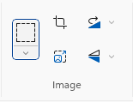
Image and Selection Tools
Select
Crop
Resize
Rotate
Flip

Slide 15
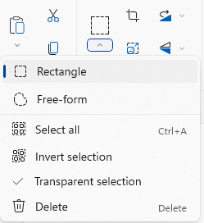
Selection is Complicated
Two types
Selection can be inverted
Transparent

Slide 16
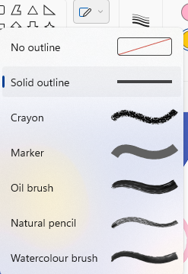
Brush Types
Shape Fill Brush
Outline Fill Brush

Slide 17
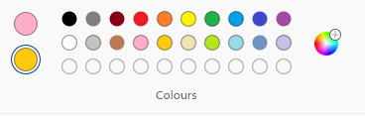
Colours – Pen / Brush (Foreground) and Eraser (Background)

Slide 18
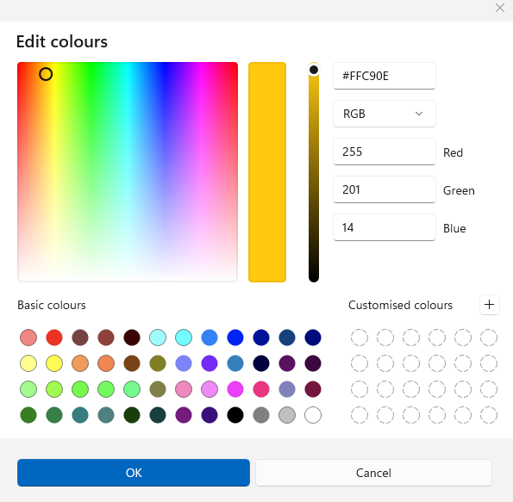
Just the Colour Chooser is a lot of work!

Slide 19
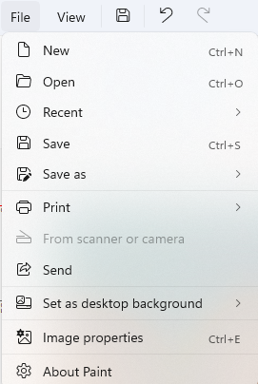
FilE Menu

Slide 20
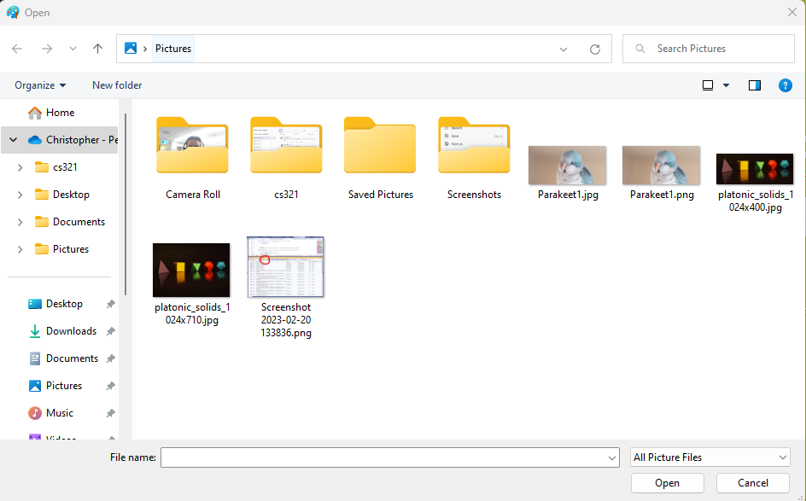
Open File Dialog

Slide 21
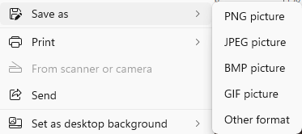
Save As Options

Slide 22

Status Bar

Slide 23

Title Bar

Slide 24
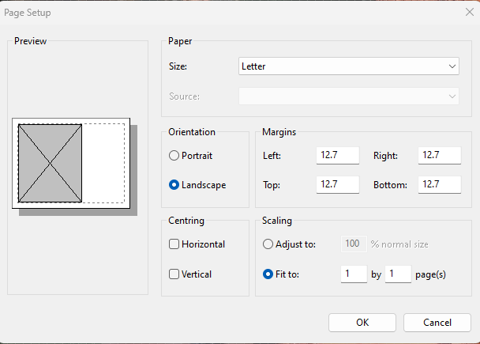
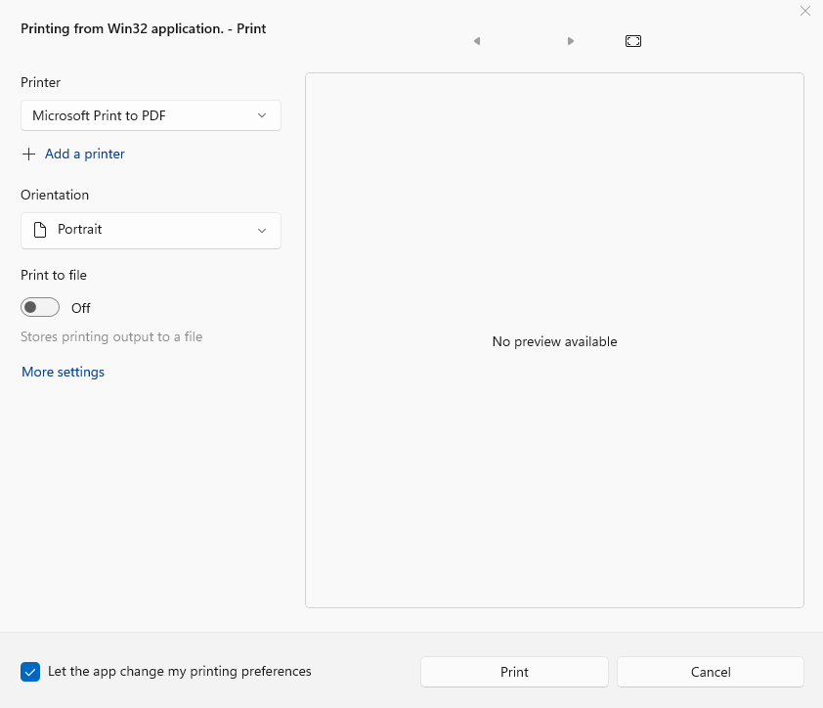
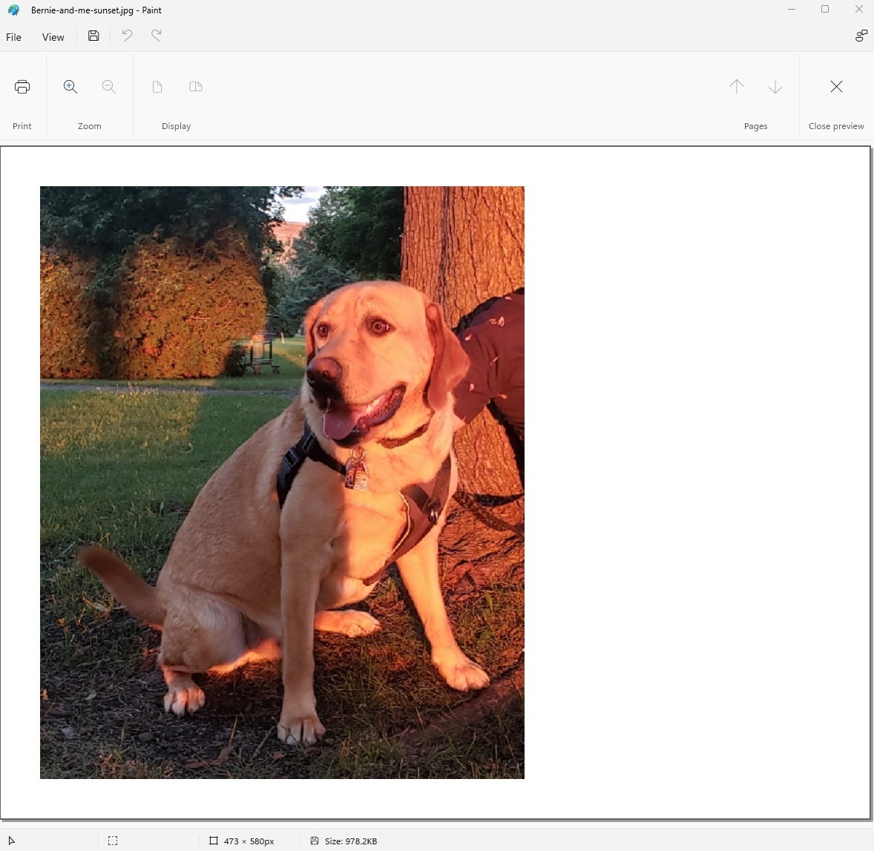
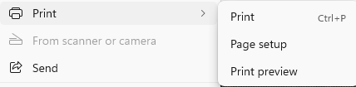
Print Dialog

Slide 25
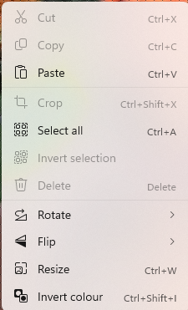
Context Menu

Slide 26
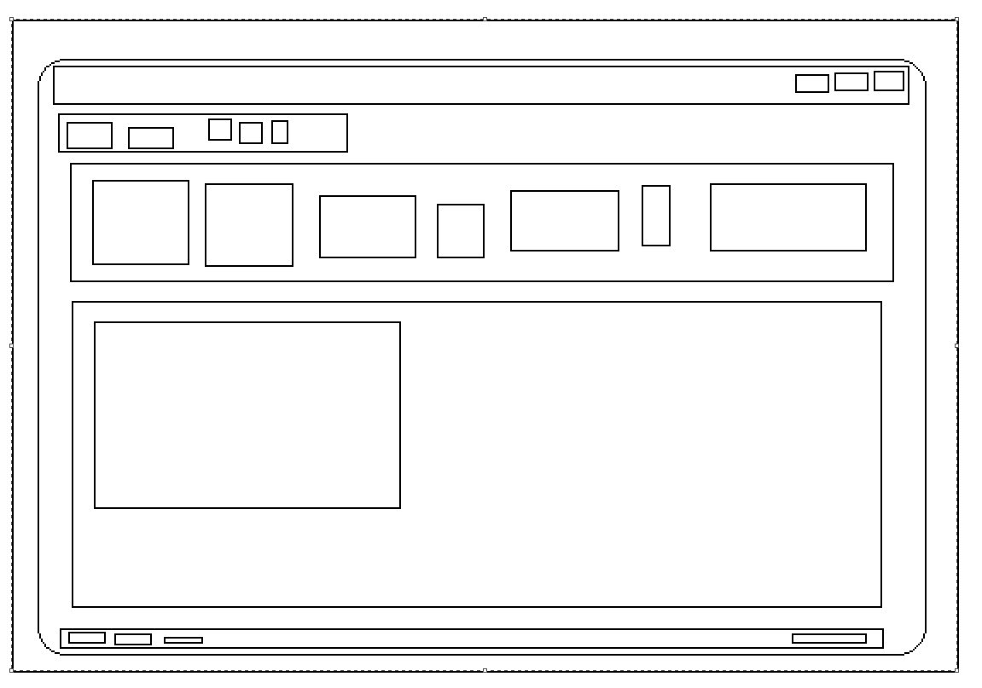
The UI – Lots of Rectangles (Controls)

Slide 27

Wow!
That’s more than it seems

Slide 28
Describing Requirements
Not an exact science
A complete specification would be source code
Some ambiguity is unavoidable
Different ways to do it
Hard but important
Be flexible and lightweight

Slide 29

Describing a Feature
How is it enabled?
Is it modal?
Does it change how keyboard or mouse input is handled?
Are there multiple stages?
Can it be cancelled?
Can it be undone?
What is the impact on the data?

Slide 30
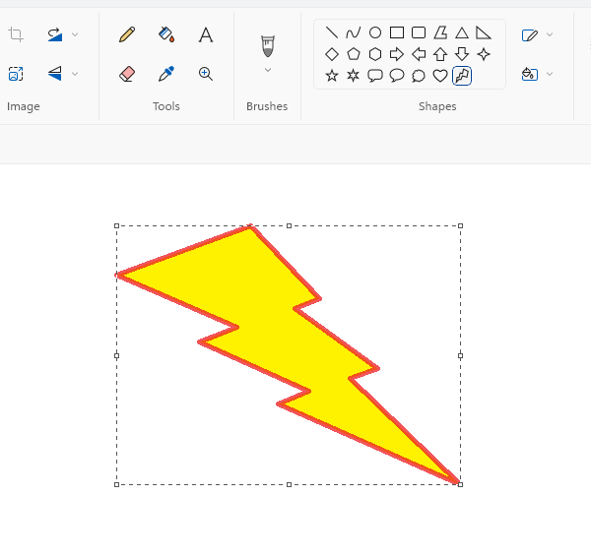
Example
The Windows Paint program: creating a shape
How would you describe it this feature?

Slide 31

Shape Drawing Operation
When the active tool is a “shape”
Left-clicking on the canvas with the mouse will start the drawing process for a shape
While the left mouse button is held down a shape will be drawn to fit a bounding box
The box is defined by the original location of the mouse and the current position of the mouse
Moving the mouse will update the drawn shape
When the left mouse button is released the shape will be selected with a rectangular selection
Selection tools are enabled (e.g., flip, rotate, move, resize) for the shape but won’t affect background
Pressing escape or delete will discard shape, and cancel the operation
Clicking anywhere in the application will complete the drawing operation and cancel selection

Slide 32
But wait … there’s more
The shape is drawn is using current pen and brush settings
border pen width
border brush style and color
fill brush style
These can be changed while the shape is selected and before the shape is completed.
That’s a lot!

Slide 33

Complexity Management
Primarily challenge of writing software is complexity management.
Problem has little to do with hardware
We are limited primarily by creativity and human ability to process complex information
Software could do virtually anything given enough
time
brainpower

Slide 34
Five Steps of Complexity Management
Eliminate redundancy
1
Maximize code reuse
2
Arrange code logically
3
Make dependencies explicit
4
Minimize dependencies
5

Slide 35

KISS Principle
Keep it super simple

Slide 36
Grouping Functionality
Namespaces
Types
Projects
Executables
Packages
Libraries

Slide 37
Modules, Components, and Units
The terms “module”, “component”, and “unit” are used to describe arbitrary groupings of code generically, independent of language. There is no formal meaning in the context of C#.

Slide 38
Namespaces
Namespace allow type to be grouped together
Can be nested
At most one namespace per file
One namespace may occur in multiple files and libraries
Allows the same name to be used in different contexts

Slide 39
Libraries (Managed Assemblies)
Any managed assembly (DLL or EXE) can be used as a library
You can add a reference directly using a file path
Any .NET libraries can reuse types from an assembly
You can view exported contents of an assembly using “object browser”
Assemblies are versioned: you should only include one version of an assembly

Slide 40
Resolving References to Assemblies
Referenced assemblies have to be discoverable
They are either registered in the global assembly cache (GAC)
Or they are in the same folder as your executable or library
Don’t forget to distribute dependencies with your executable or library
Look-up happens at run-time, the first time the referenced type is used

Slide 41
Project References
Within a solution you can create references between projects
This allows visual studio to take care of compiling things in order
Also copies the dependencies to the executable folder

Slide 42
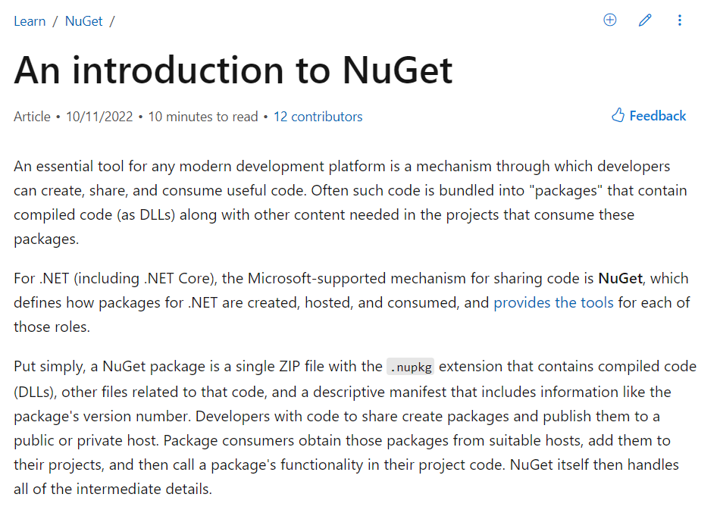
Nuget Packages

Slide 43
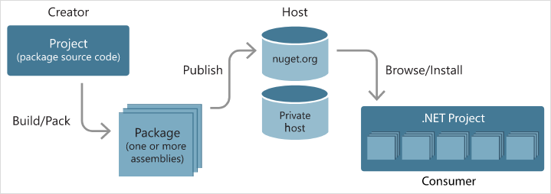
About Nuget
https://learn.microsoft.com/en-us/nuget/what-is-nuget

Slide 44
Examples of Libraries as Nuget Package
Manipulating, reading, and writing image data – ImageSharp
Parsing the command-line – CommandLine
Saving arbitrary data to Json – NewtonSoft
Writing and Running Unit Tests – NUnit

Slide 45
The golden rule
Don’t copy code!

Slide 46
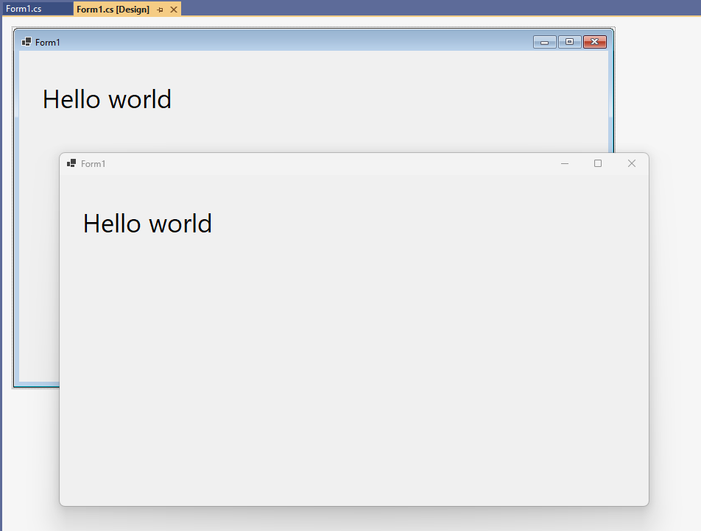
Bonus Lab + 1 Point
Create a “Hello world” Windows Forms Application (aka Winforms).
Open the form in the designer
Go to “Window > Toolbox” in Visual Studio
Drag and Drop a “Label” Control onto the form
Change the text of the label using the “properties” of the control
Screenshot it

Slide 47
Object Oriented Design
What are the nouns?
These are our classes
What are the verbs?
These are our methods

Slide 49
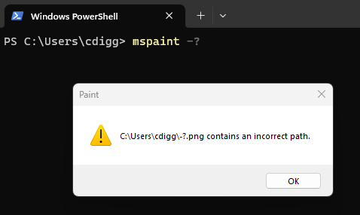
Even GUI Applications take command-line arguments

Slide 50
Basic Parts of a Windows UI Application
Menu
Toolbar
Context menu
Status bar
Window

Slide 51
GUI Applications
Basically a big “while loop”
Waits for Windows message (data packet)
When it arrives does something (or ignores it)

Slide 52
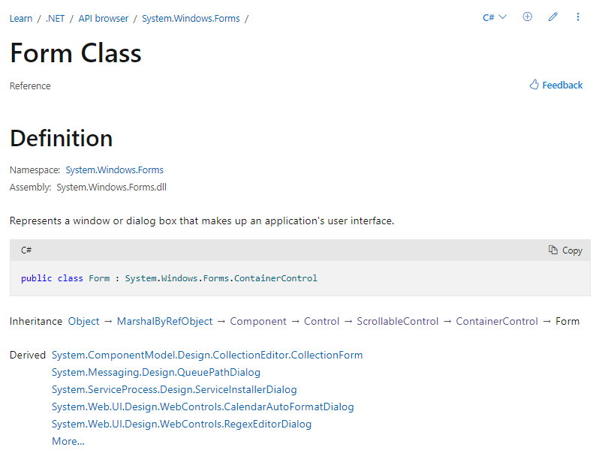
Windows Controls
GUI Applications are good examples of using Object-Oriented Programming

